Slide 1
Graphs, tree and more…
in a photonic architecture!

Slide 2
Question. Given a tree T, how many outer loops do I need to implement it?
Answer. It depends on the order O in which I add the vertices of T.
We will study the function C(T, O)

Slide 3
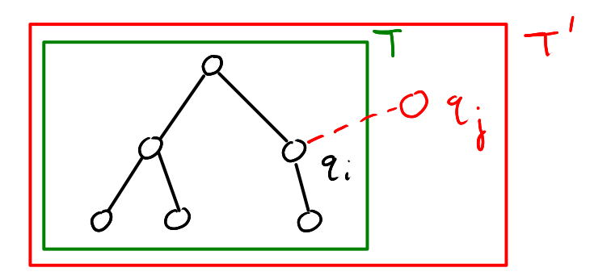
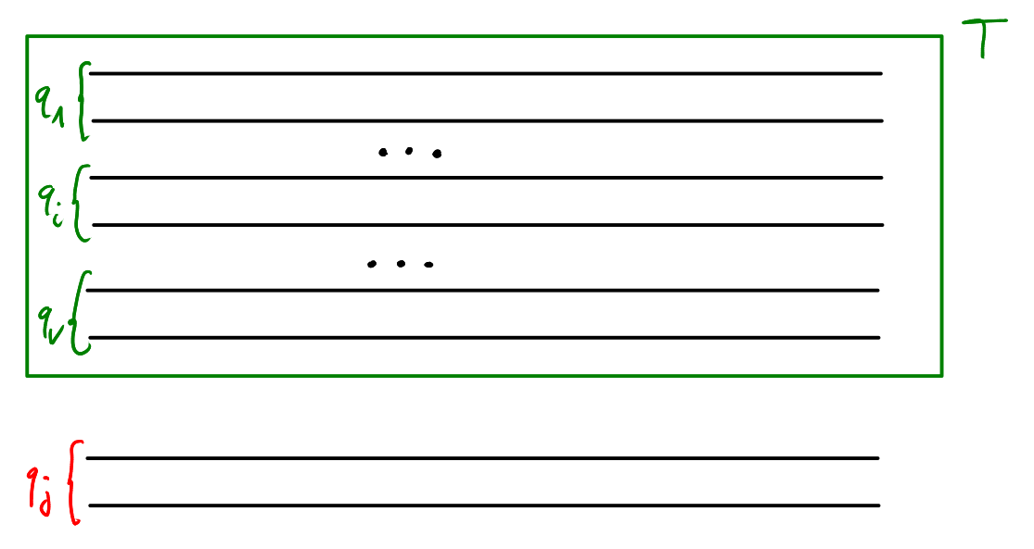
General algorithm to add a node.

Slide 4
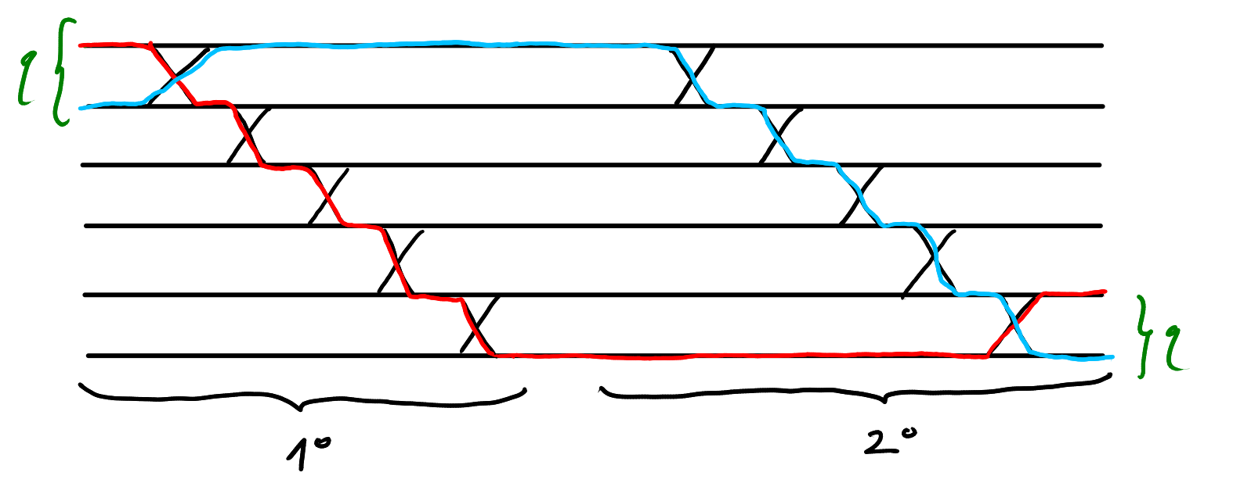
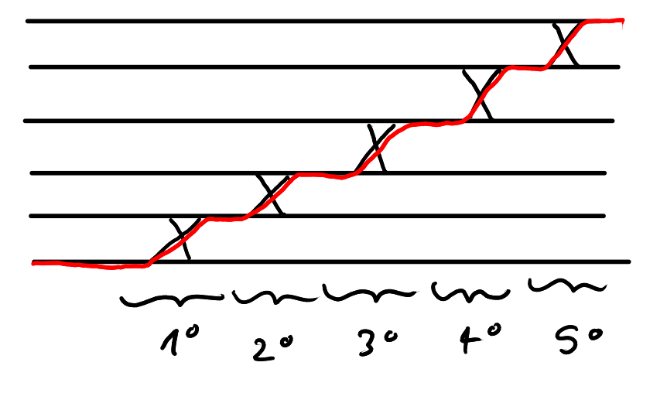
v
sinking :)
sinking :)
lifting :(

Slide 5
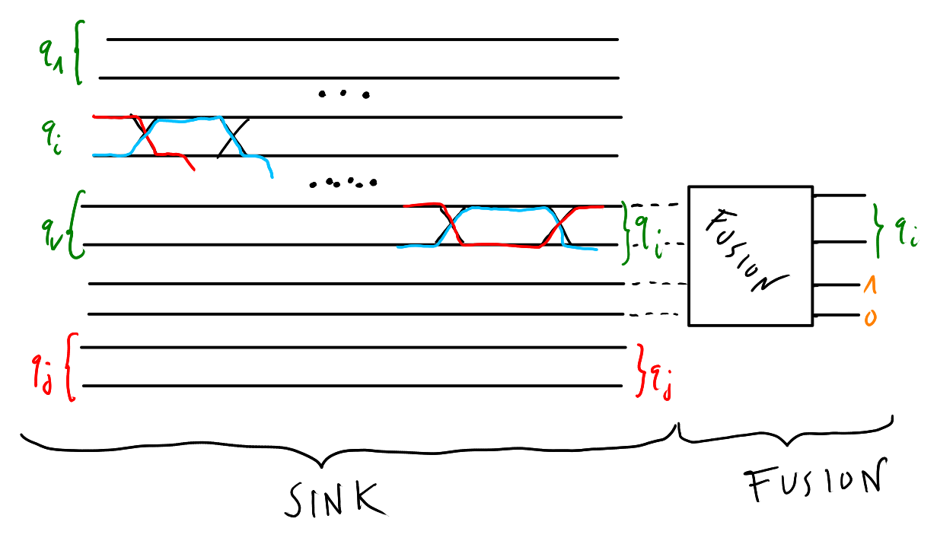
add_edge(i, j):
sink i to the end of the circuit
fuse i and j

Slide 6
A good class of orders:
DFS-orders

Slide 7
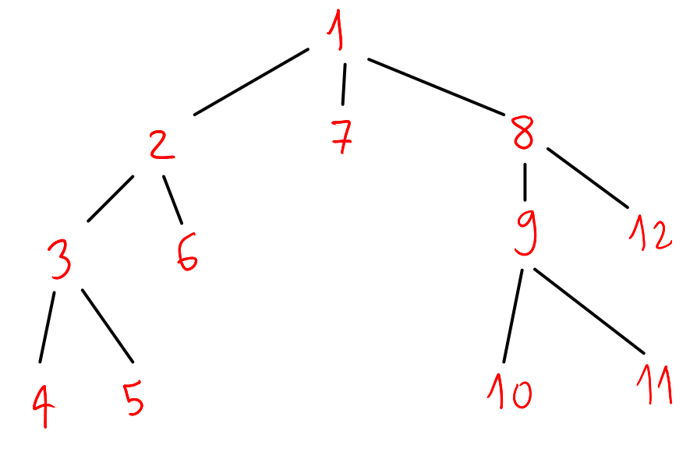
Review: the DFS algorithm
1 → 2 → 3 → 4 → 5 → 6 → 7 → 8 → 9 → 10 → 11 → 12

Slide 8
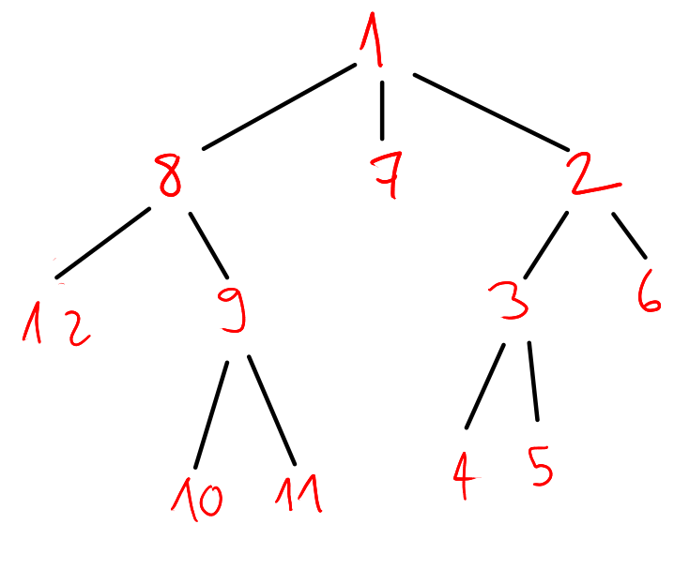
The DFS algorithm gives us a possible order on the tree. But we are left with some freedom:
we can decide in which vertex to start the DFS algorithm;
given a vertex, we can move around it’s children.
≈
1 → 2 → 3 → 4 → 5 → 6 → 7 → 8 →
9 → 10 → 11 → 12
1 → 8 → 12 → 9 → 10 → 11 → 7 → 2 →
3 → 4 → 5 → 6

Slide 9
Optimizing on the starting vertex is easy: it takes O(V).
Optimizing on the children order is an nightmare: exploring all the possibilities would take exponential time.
Thankfully recursion and the DFS algorithm are best friends!

Slide 10
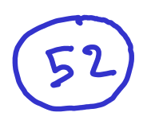

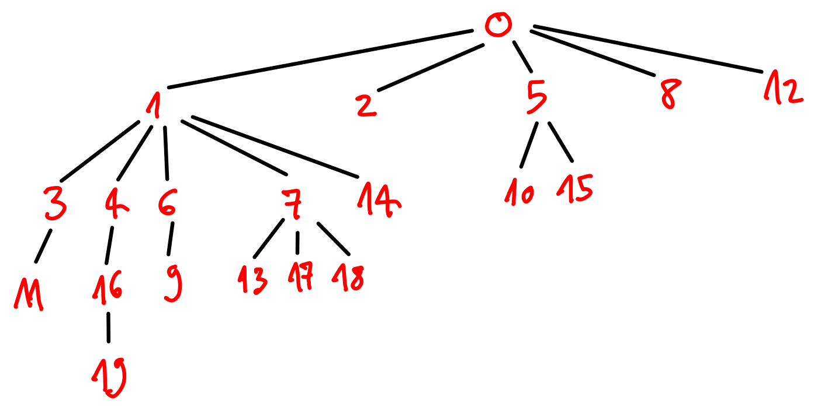

Slide 11
The optimal DFS-order
How to find it
(recursively)

Slide 12
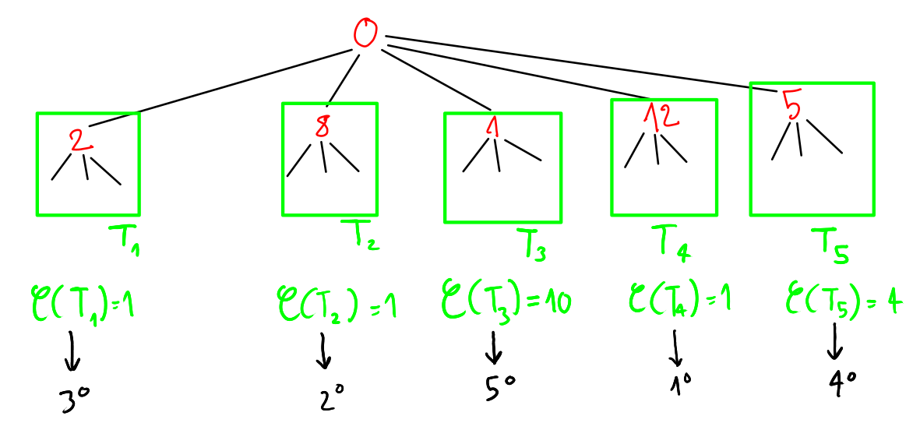

Slide 13
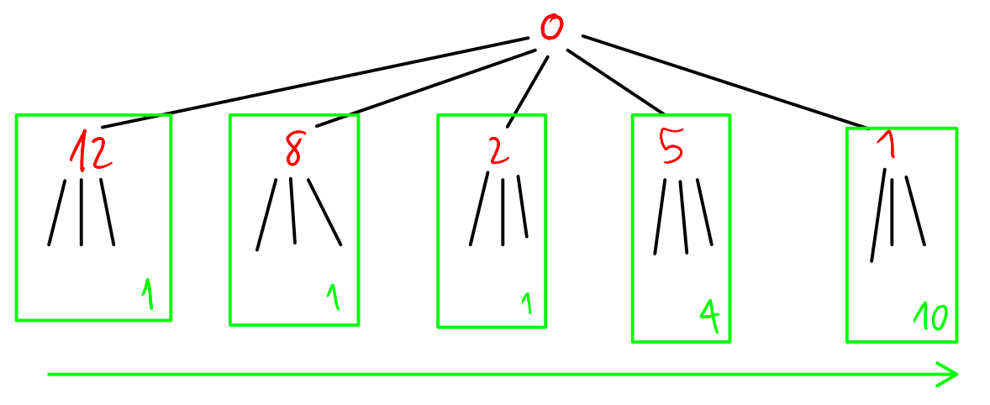

Slide 14
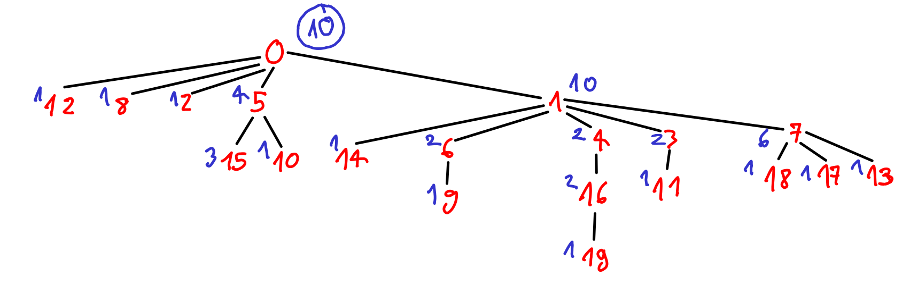


Slide 15


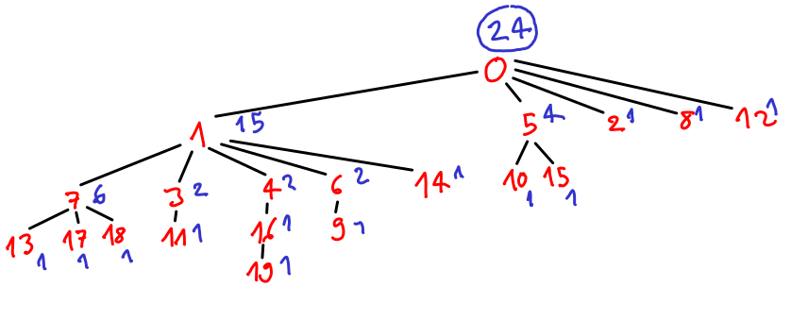
What happens if a devil puts a mirror aside the optimal ordered tree? We get the worst DFS-order!
In general the worst DFS-order is still better than the random order with started with!

Slide 16
To recap:
52 ≫ 24 ≫ 10
random
worst DFS
best
DFS
We found our optimal answer. It depends on the tree T and the starting vertex v from which we start our recursion: C(T, v).
Notice that this function C takes O(V) time to be computed.

Slide 17
Recursion is a really powerful tool:
we reduced the complexity of the optimization problem;
it helps us also from a formal point of view, to write proofs and analytic bounds.

Slide 18
Theorem. Given a tree T and a DFS-order O on T that starts from the vertex h, we have the following bounds for the function C(T, O):
C(T, O) ≤ max{b(p)} on all the possible paths from h to a leaf
≤ (d-1)(max{c(v)} – 1)+3 for all the vertices v in the tree
where c(v) is the number of children of the vertex v and b(p) is the sum of c(v) – 1 for all the vertices v on the path.

Slide 19
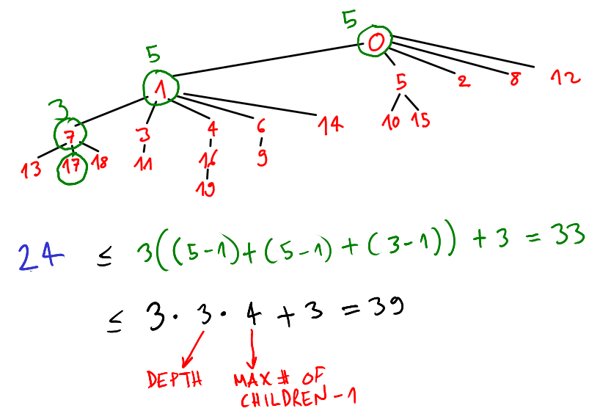
C(T, O) ≤ max{b(p)} on all the possible paths from 0 to a leaf
≤ ( d-1 )( max{c(v)} – 1 )+3 for all the vertices v in the tree

Slide 20
( d-1 )(max{c(v)} – 1)+3
This last bound is really important, because it tells us that all the DFS-orders are in some sense really good orders. In fact the depth of the tree usually grows as ln(V), while the maximum number of children is a constant.

Slide 21
Given a tree T, we understood how to build the optimal circuit from it. Let’s go back to the original problem.
Question. Given a graph state G, how many outer loops do I need to implement it?
Answer. It depends on what tree we extract from the graph.

Slide 22
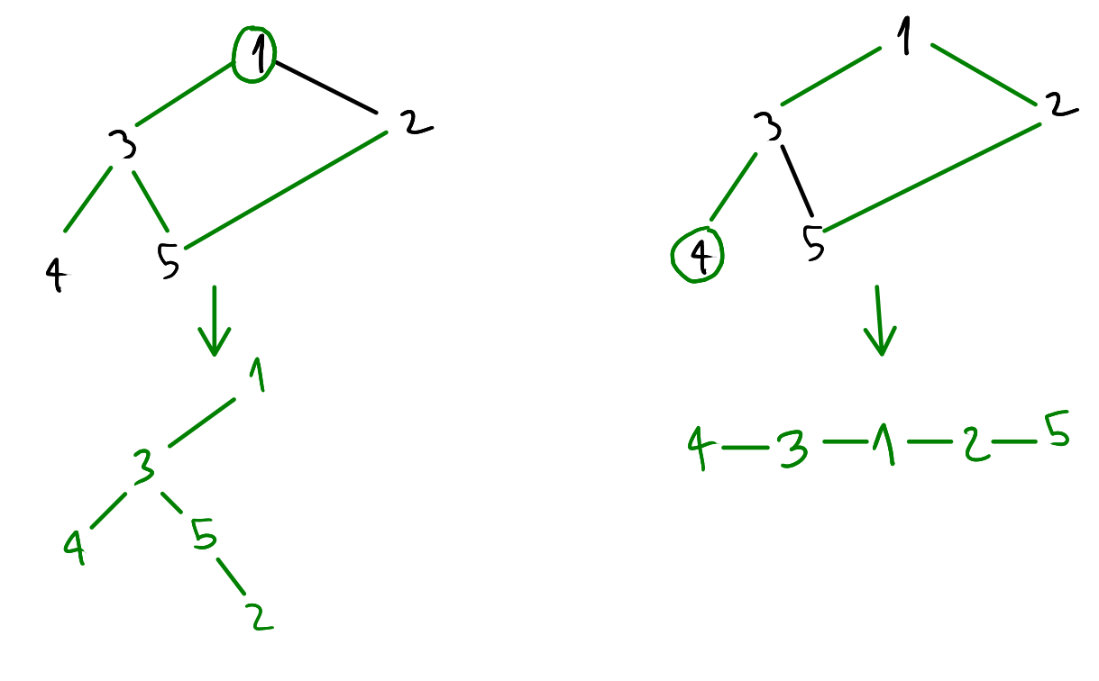
Review: the DFS algorithm to extract a tree from a generic graph.
The topology of the extracted tree depends on the starting vertex!
We need to iterate on all the possible starting vertices to extract V possible trees (O(V) )

Slide 23
optimal_circuit(given a cluster state G):
answer = ∞
for every vertex v in G:
extract tree T given by a DFS starting from v
for every vertex v’ in T:
answer = min(answer, C(T, v’ ))
It takes O(V³)

Slide 24
One last step: some ZX-calculus optimization
Now we just have to optimize on all the ZX graphs that are ZX-equivalent to our original unitary U. This allows us to use local complementation and pivoting to get a smaller circuit. In other words we are interested in
min optimal_circuit(G) on all G that are ZX-equivalent to U

Slide 25
Future developments.
Introducing gflow and time cones in our MBQC gives us the possibility to have a variable number of inner loop, because we can “measure on the way”.
For now, the number of inner loop is fixed by the number of vertices of the graph state, so we just seek the smallest number of outer loops.

